Slide 1
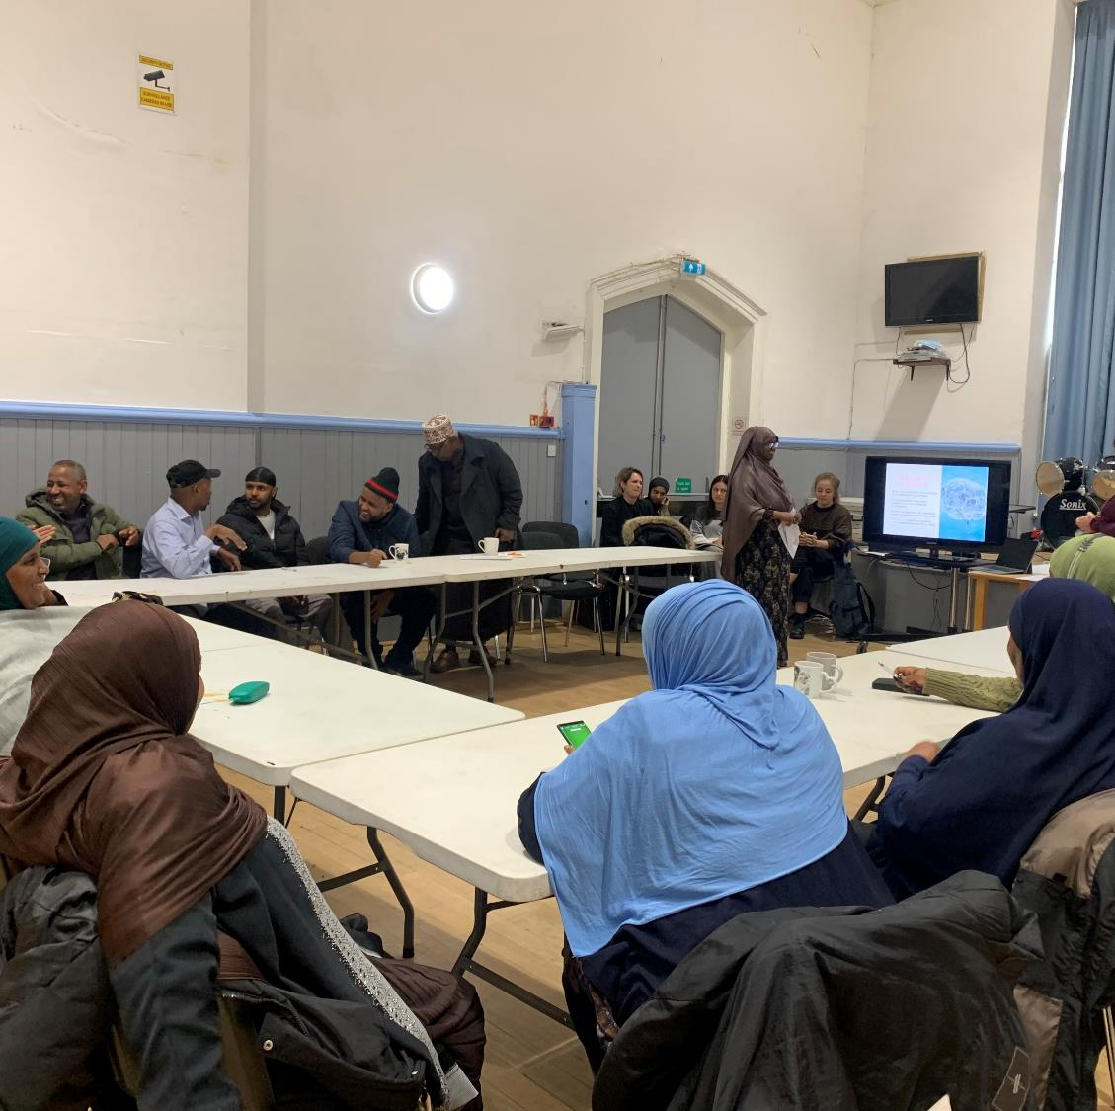
Fostering Inclusivity in Neurotechnology Research

Slide 2
Introducing NeuroMod Project
A community-engaged project to explore ethical inclusivity and acceptability in neurotechnology
Collaboration between researchers and African ethnic minority communities in the UK

Slide 3
Hypothesis
“Engaging directly with the underrepresented communities will reveal specific cultural, religious, and logistical needs that, if addressed, can significantly increase acceptance and participation in neurotechnology studies.”

Slide 4
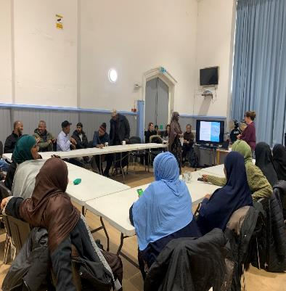
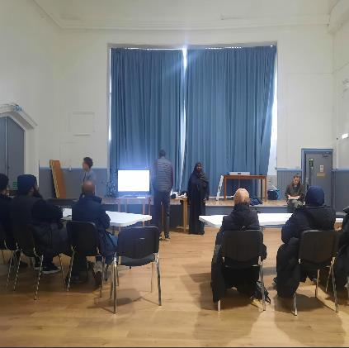
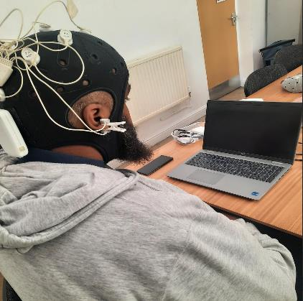
Methodology
(1) Workshop 1
(3) Workshop 2
Neuroimaging workshop/demonstrations
Group Discussion
Brain stimulation
workshop / demonstrations
Group Discussion
(2) Data Collection
(4) Workshop 3
One-on-one sessions
EEG/fNIS / Interviews
Reflection/Feedback
workshop/demonstrations
Group Discussion

Slide 5
Voices from the Community
“
Quote 1:
“Our community rarely joins studies like these, so it feels like our contribution really matters.”
”
“
Quote 2:
“After taking part, I fully support this kind of research if its goal is to help the community. I’d be happy to participate again in the future.”
”

Slide 6
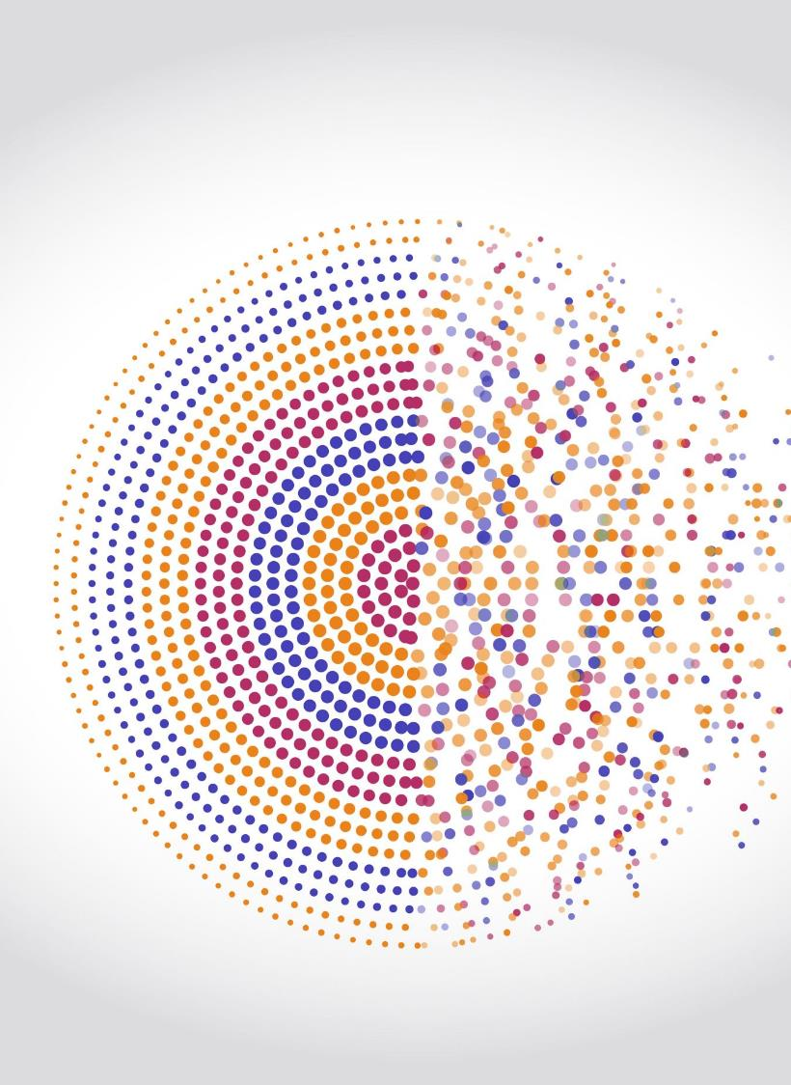
Inequality in Neurotechnology
Case Study on Systemic Exclusion in BCI Trials

Slide 7
Broader Issue:
In many publications, we observe that participants are excluded from neurotechnology studies. The reason is typically politely attributed to "low-quality data", without critically examining whether the problem lies in the limitations of the design, which is often not designed with inclusivity in mind.

Slide 8
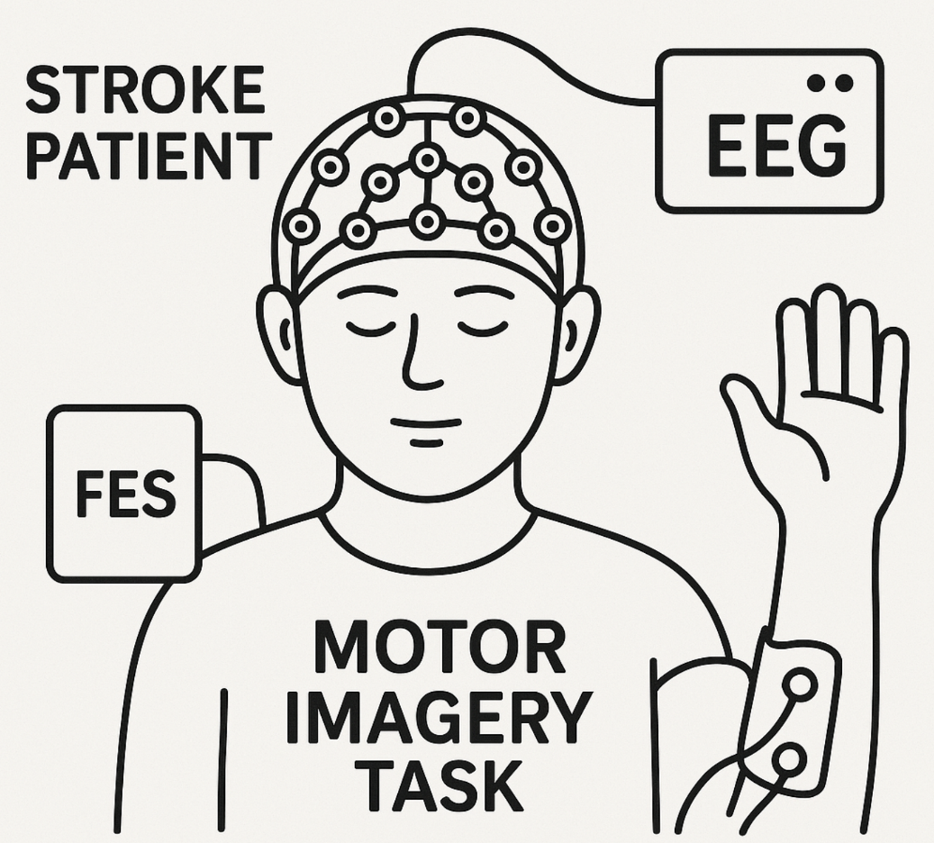
Case Study:
A clinical trial tested a motor imagery Brain-Computer Interface (BCI) system for stroke rehabilitation. The setup used EEG to detect imagined movements and activated Functional Electrical Stimulation (FES) to support hand movement (open/close).

Slide 9
Case Study:
The system was non-invasive, using an EEG cap and FES device.
One of the participants was a young African man who had recently suffered a stroke.
He had limited access to treatment options and was highly motivated to participate

Slide 10
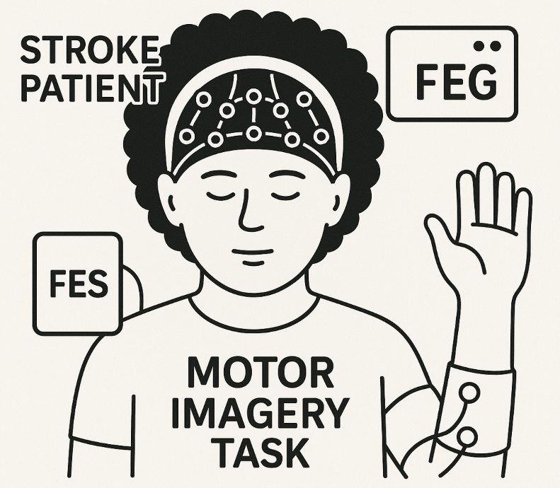
What happened:
The participant had a traditional African hairstyle.
Despite 30 minutes of setup, the EEG system failed to record usable brain signals.
As a result, the participant was excluded from the trial.

Slide 11
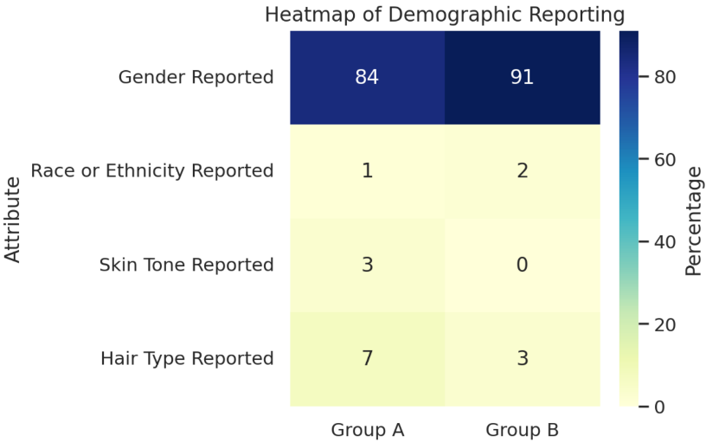
Likewise !
In functional near-infrared spectroscopy (fNIRS)—a non-invasive method that uses light to measure brain activity—another form of lack of inclusivity.
fNIRS relies on near-infrared light to detect blood oxygenation levels.
Skin tone—especially in darker tones—can attenuate near-infrared light, potentially affecting the accuracy of hemodynamic measurements.
Yet these factors are rarely accounted for in device design or data interpretation.
90 studies published in leading biomedical optics journals
87 articles from neuroscience journals

Slide 12
Lessons Learned
Inclusion Begins with Listening
Ethics Is Ongoing, Not One-Off
Representation Shapes Outcomes
Trust Takes Work
User Involvement Changes the Research

Slide 13
Thank you for Listening

