Slide 1
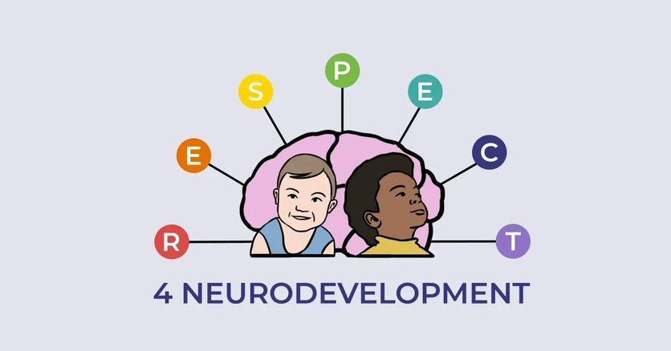
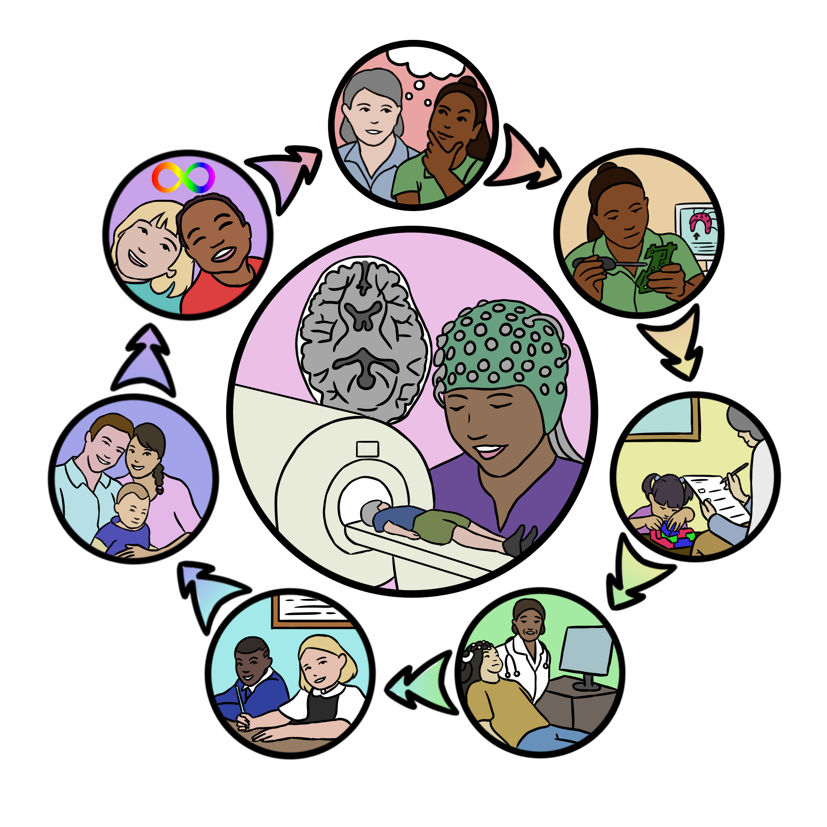
WARM WELCOME TO
Responsible Neurotechnology
Eva Loth,
Institute of Psychiatry, Psychology and Neuroscience, King’s College London

Slide 2
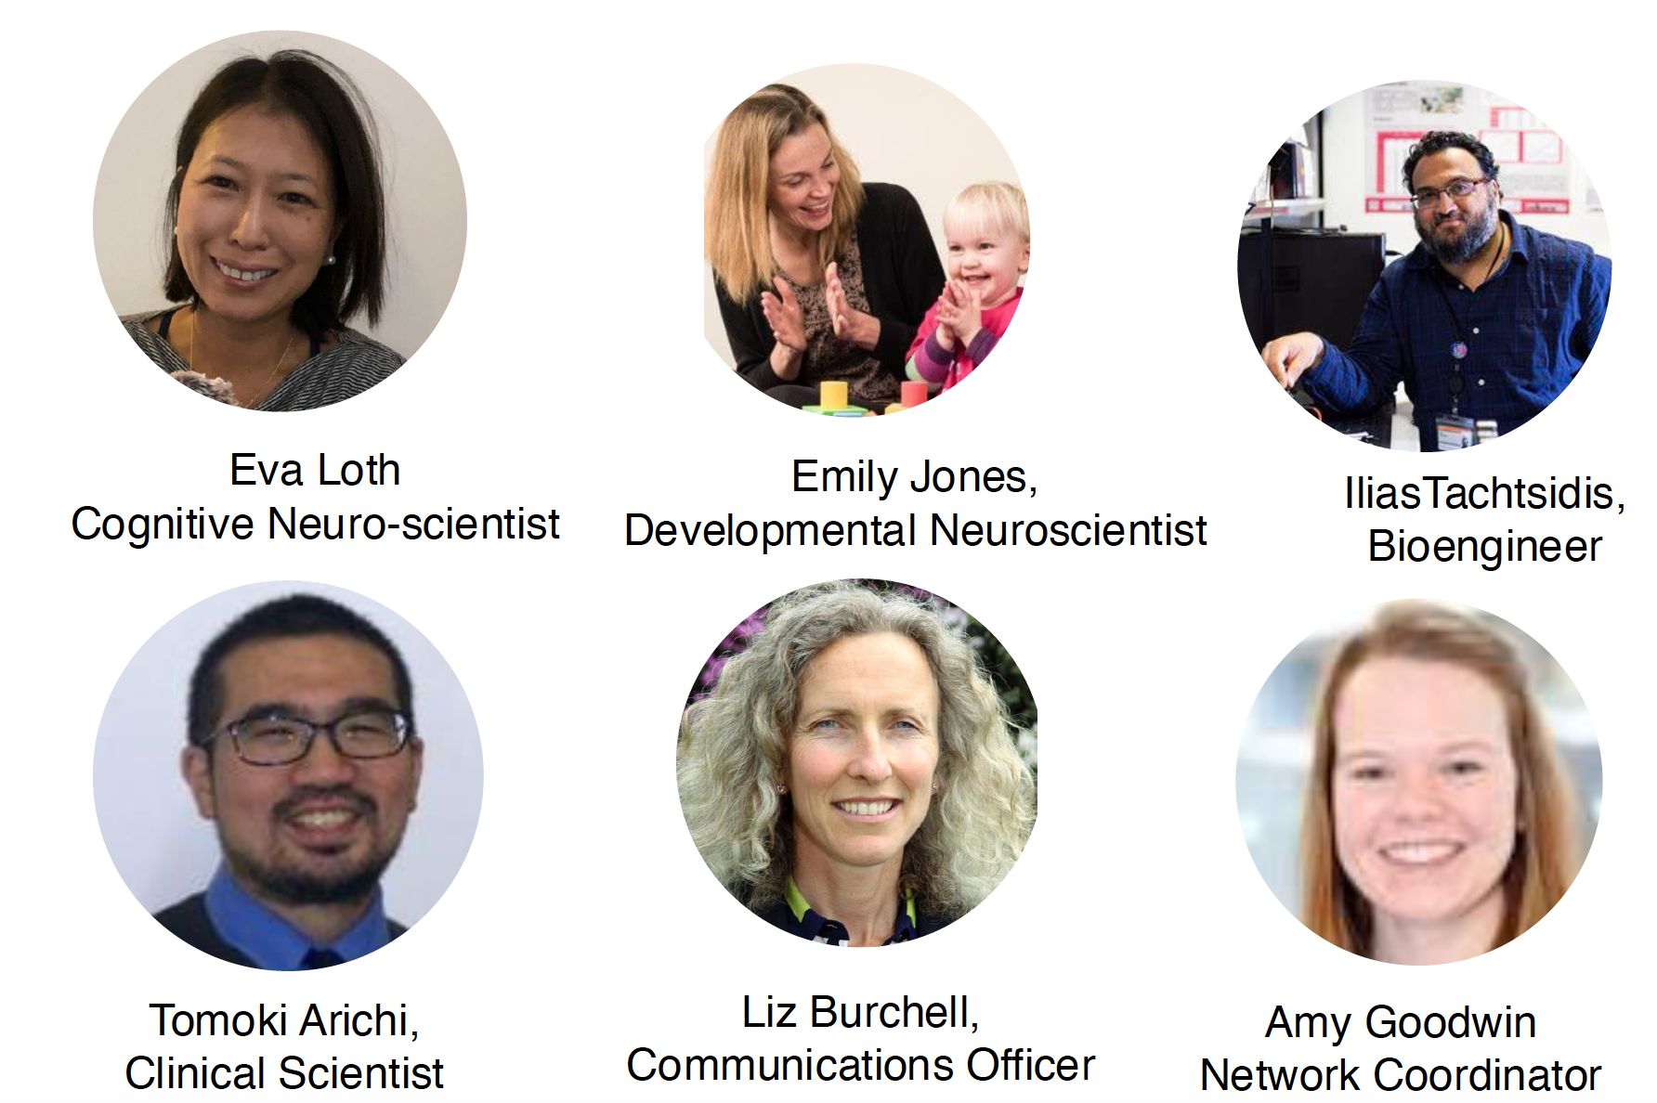
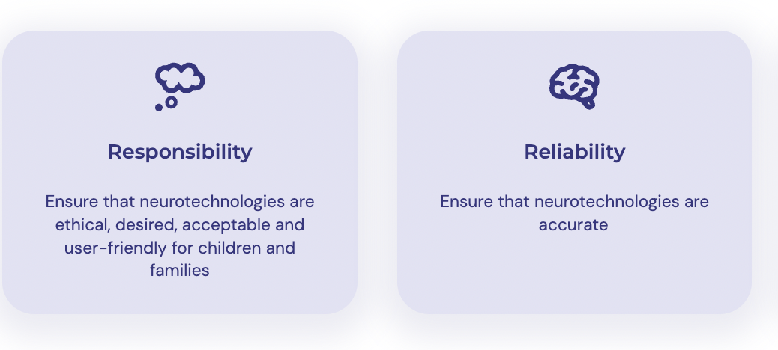
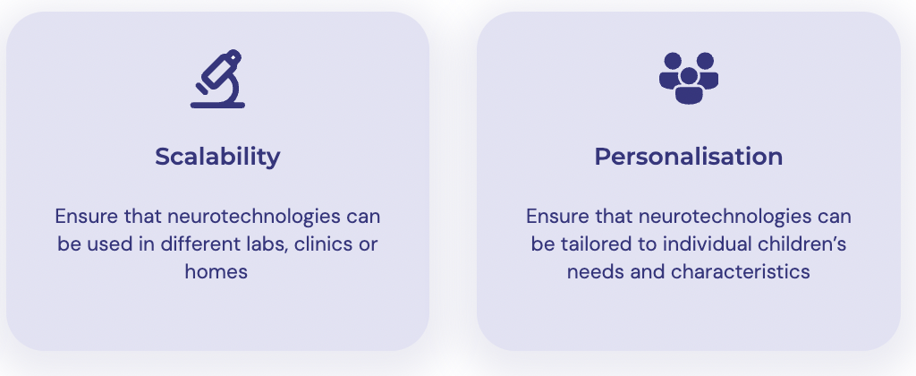
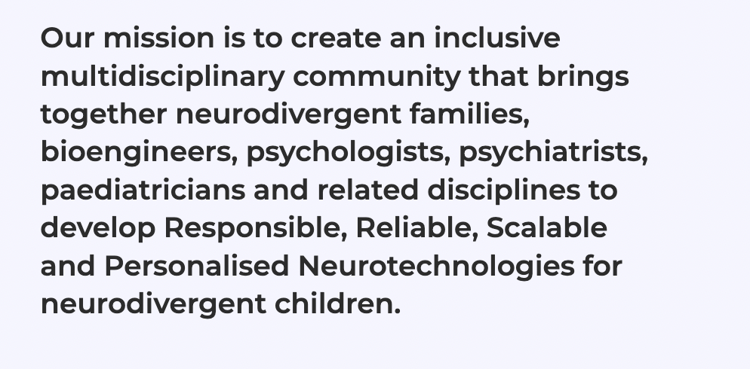
Respect4Neurodevelopment

Slide 3
Paediatric Neurotechnologies for Neurodiverse
Populations: Benefits, Risks and Unknowns
Neurotechnology has the potential to revolutionize precision health - early detection, prognosis, targeted intervention/ support for neurodivergent children, but…
How can we ensure that the development, application and implementation of new neurotechnologies is ethical, safe, does not cause harm, is desired by children/ families, and societal beneficial?
”New” ethical and legal issues: What are the long-term effects of neurotechnologies on neurodivergent people’s lives, and who can access them?

Slide 4
Objectives of the Responsibility Working Group
Identify main priorities and challenges for the responsible development and use of neurotechnologies with (potentially) neurodivergent infants and children for different applications
Outline avenues to address them
Interface between participatory research, ethics and other working groups
Help network members to be aware of/ address these considerations
Build on work on ethical considerations for neurotechnologies and AI: Intersection between child-centred neuroethics and ”neurodiversity-centred” neuroethics
Yuste et al., 2017, Nature: Four ethical priorities for neurotechnologies and AI: Identity, agency, privacy and equality,

Slide 5
Responsibility as first ‘pillar’ of network activities
Working group
Ongoing project on neurodivergent people’s views on different types of neurotechnologies for different applications
Pump prime projects need to demonstrate how they include PPI and deal with ethical issues
PPI advisor on review committee
PPI-led funding call (2025)
To train researchers in carrying out participatory research: Thematic analysis stream in Autumn School

Slide 6
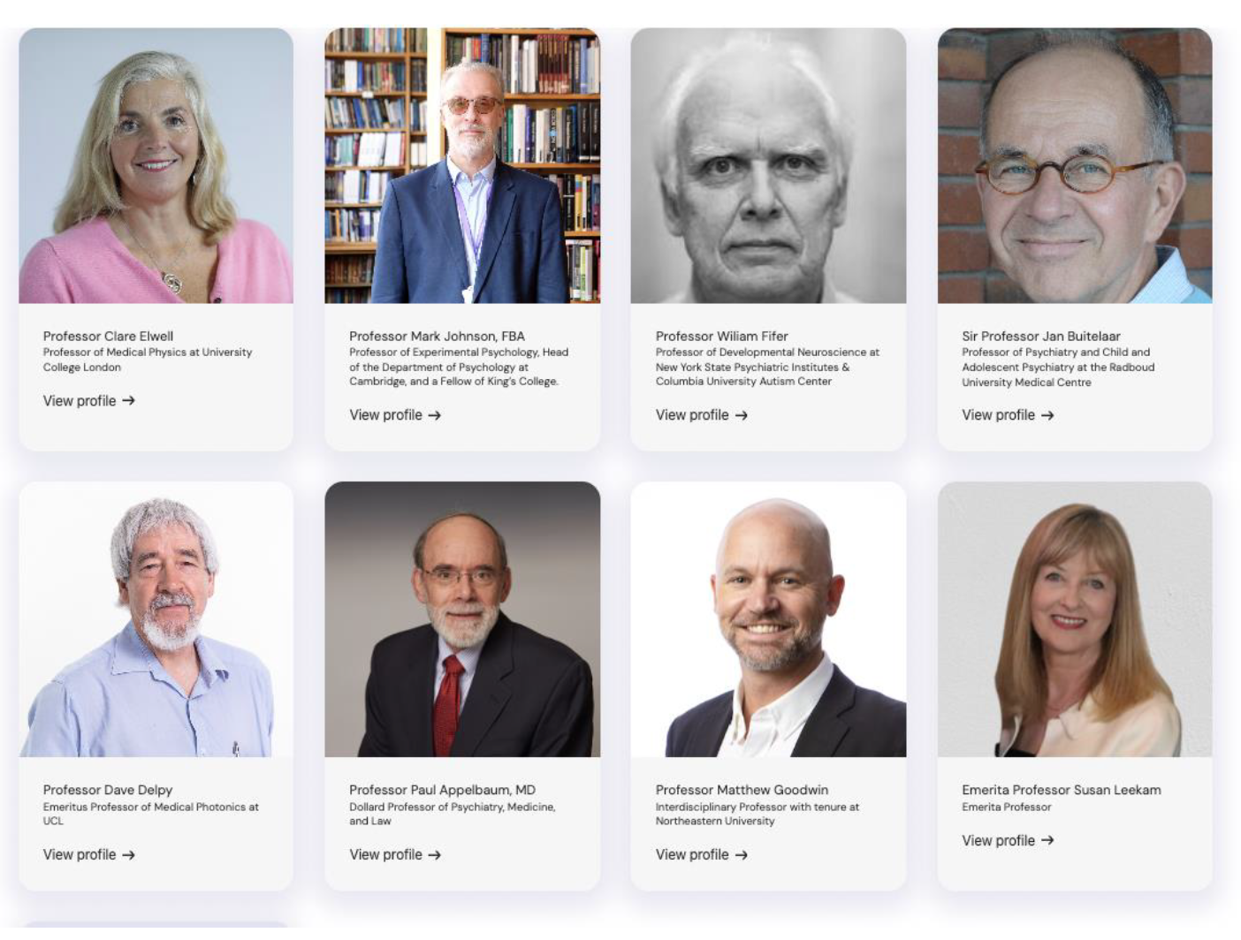
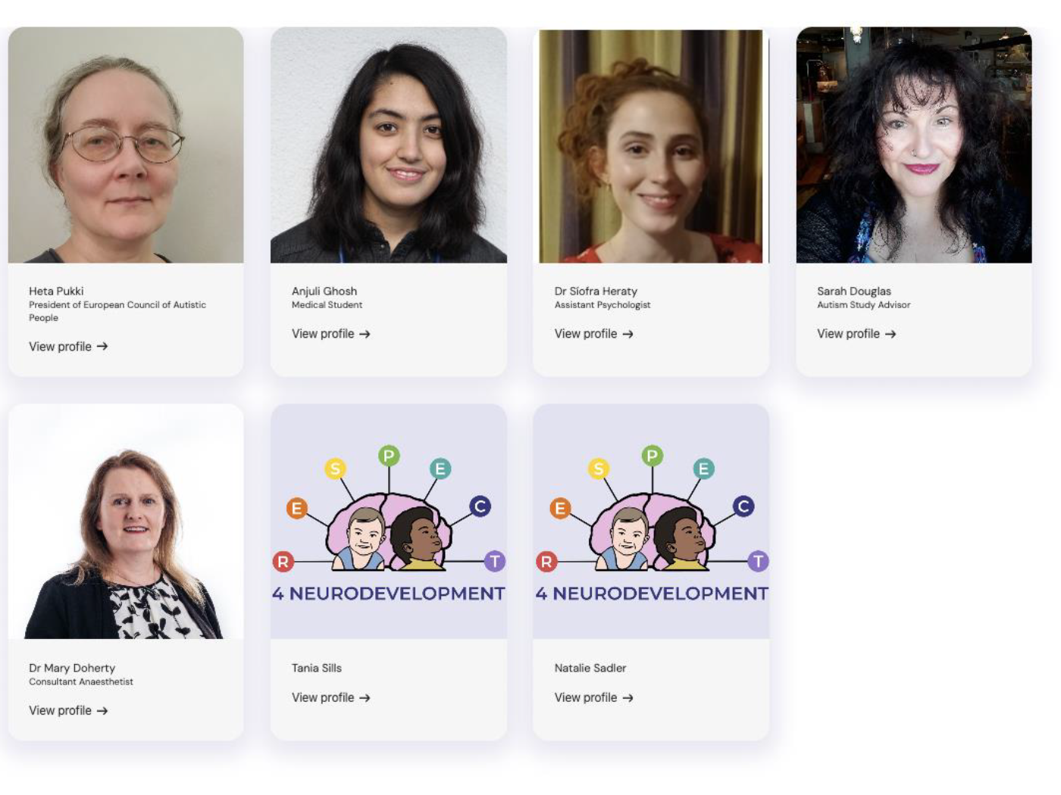
Changes in power structure
Scientific Advisory Board
Participatory Research Board

Slide 7
How to set priorities?
How to set (research, funding) priorities?
Utilitarian; the greatest amount of ‘good’ for the greatest number of people
Underserved populations, possibly with some of the highest/ most urgent support needs (that may not get support otherwise)
Projects most likely at the cusp of break-through

Slide 8
What are the risks and unknowns of different types of neurotechnologies used for different purposes?
Risks and unknowns linked to a particular applications (irrespective of technology)
Precision health:
Early identification
Prognosis
Subgrouping/ transdiagnostic approaches
intervention
Risks and unknowns linked to particular neurotechnologies

Slide 9
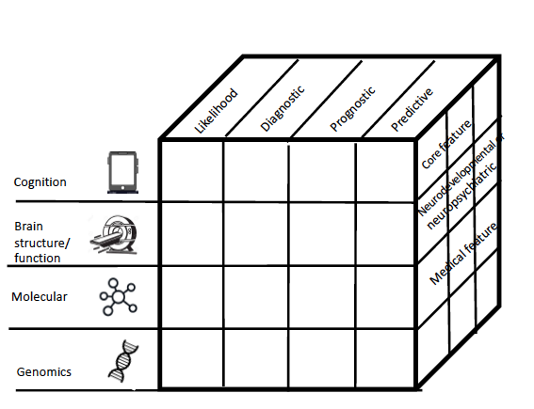
What kind of biomarkers do autistic people (not) want?
What is the clinical application?
Type: What is the biological characteristic and test used
Outcome: What is the clinically-relevant feature that the biomarker predicts?

Slide 10
Using neurotechnology for early identification, prognosis
What are acceptable levels of accuracy or probability of biomarkers or tests for
Likelihood of neurodevelopmental conditions (e.g., autism)
Prognosis of a particular developmental outcome (e.g., likelihood of autistic child to develop ADHD or anxiety), is this different for biological vs social characteristics that may be modifiable to different degrees?
False negatives are a problem – could prevent access to services for years
False positives may impact on how parents/ teachers interact with their children (“lower expectations”)
Do views of parents, neurodivergent people, professionals converge?
Who can choose to take tests once available?

Slide 11
Transdiagnostic approaches: Using neurotechnology for (brain-based) subgrouping
Increased personalisation of support based on profile of needs
May blur autistic identity/ sense of belonging to autistic vs broader neurodiverse community
Aligned with variation of human neurodiversity - reduce stigma associated with autism?

Slide 12
Early intervention/ pre-emptive intervention
Interventions for what features?
Are those features disabling for the child (their quality of life) or problematic from a neurotypical perspective?
Is the intervention specific (if known)?
Possibly unknown as the developing brain itself is not fully understood, the nature of ”atypicalities” (interactions, compensation, adaptation) and if it targets a “mechanism” that may affect different outcomes?
Does the intervention aim to ‘normalize’ a child (e.g., ABA)
Invasive technologies (e.g., Deep Brain Stimulation): Infringe on identity/ agency (e.g., brain stimulator to treat depression)
How can long-term effects be practically assessed/ funded?

Slide 13
What are the risks and unknowns of different types of neurotechnology?
Examples:
Brain-computer interfaces, assisted communication that enable (neurodivergent) individuals to communicate by eye-movements
Infringe rights to private mental lives, agency
Cognitive enhancement tools (transcranial electric stimulation)
potential pressure to use technologies, loss of authentic self
(Continuous) measure of brain reponses, attentional/ emotional responses (wearable devices)
sense of surveillance, loss of privacy

Slide 14
How can we include the views and interests of infants and children?
Ask parents and make explicit they are asked to
take the perspective of the child: what is in the best interest for the child, why?
what is in the best interest for themselves/ siblings, other family members
Ask teenagers who can easier (?) remember what it was like to be a child
In some instances, ask children themselves or give choices to see how they interact with devices, how comfortable they are, what they prefer?
Who should take decisions for (potentially) neurodivergent infants and children? (e.g., if priority for child and parent may differ?)

Slide 15
Equity, Accessibility and Burden
Concern (some) neurotechnologies may perpetuate or exacerbate inequalities
Who can take part in research
Predominant white middle-class samples that may create biases
Who will have access to [particular] neurotechnologies?
Burden on families (stressful experience, neurodivergent child gets singled out)
Potential costs?
Uncertainties around reimbursement, insurance
Should equity/ accessibility inform research priorities (in favour of lower-cost technologies, or should the ‘best’ technologies be pursued, hoping that they will drive cost reductions (see whole genome sequencing)

Slide 16
Who is Responsible and who Monitors Responsibility?
Medical devices are regulated, devices used by families, educators, even in research, are not?
EPSRC encourages innovators to “anticipate, reflect, engage and act” in ways that “promote…opportunities for science and innovators that are socially desirable and in the public interest”.
“Hippocratic oath” for engineers/ developers?
Safety and efficacy: How can long-term effects on safety and efficacy be tested (several years after project end?)
Should this be built into grants

Slide 17
Whose perspectives should be included in developing and implementing responsible neurotechnologies?
Bioethicists - Child-centred/ neurodiversity-centred neuroethics
Neurodivergent children, parents to ensure neurotechnologies are desired and address real-life needs and practicalities
Disability rights advocates – protect rights and autonomy
People from diverse cultural and socioeconomic backgrounds- reduce biases
Engineers, developers, industry - capabilities
Neuroscientists – effect on developing brain
Clinicians, psychiatrists – clinical utility
Psychologists – effect on cognitive and emotional processes
Social scientists – societal impact
Funders– study design, long-term effects?
Health care providers – criteria for implementation
Insurance companies – reimbursement
Policy makers and regulators – shape legal and regulatory frameworks

Slide 18
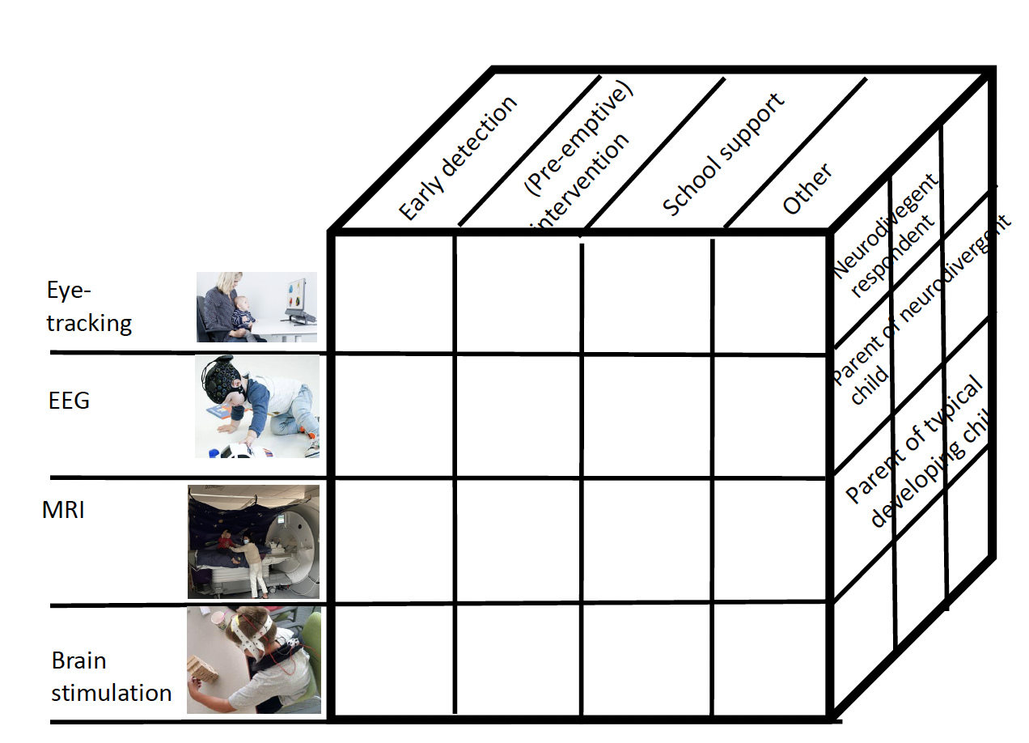
Summary and outlook
Bioethics is currently not part of training for psychiatrists, psychologists, neuroscientists or bioengineers
Organise a primer on child-and-neurodiversity centred neuroethics
Complete project on risks and benefits of different types of neurotechnologies for different clinical applications?
Co-produce white paper

Slide 19
Thank you!
Scientific Advisory Board
Participatory Research Board

