Slide 1
SOLACE: Safe Opioid management with Large-language models through Alignment, Control, and Evaluation
Pranav Mahajan, NDCN, University of Oxford

Slide 2
Motivation & Background
Opioid crisis: 107,600+ overdose deaths in US (2021); 13% of UK population prescribed opioids (2018)
NHS burden → growing push for digital deprescribing pathways highlighted by NICE guidelines
Large Language Models (LLMs) have transformative potential in opioid management but is accompanied by significant risks.
Lastly, opioid management setting is also a good use-case for other instances of LLM-integration in patient-clinician interaction

Slide 3
The safety problem is a socio-technical problem
A technically robust system when misaligned with human values or intentions can cause unprecedented societal harm
So what should we do?
Co-design it with all stakeholders involved (e.g. patients, clinicians)
Define what a therapeutically aligned system would look like and iterate on it
Create bespoke evaluations and monitoring
Two kinds of interventions:
Capability modifying interventions
Societal adaptation interventions
Develop threat models - What could go wrong? How would it go wrong?

Slide 4
How should an AI chatbot get integrated?
Help clinicians identify patient’s top 3 concerns
Perform regular check-ins on the patient
Provide evidence based recommendations

Slide 5
Possible threat models
Clinician over-reliance on AI
Disempowerment and high-stakes decisions without expert oversight
Or patients may learn to manipulate AI-mediated interactions to influence prescribing decisions
Socio-affective dilemmas
Should the AI prioritize a patient’s immediate needs/preferences or challenge them for long-term well-being?
This starts a discussion about what characterises an unsafe response
Emotional dependence
A highly personalized, persuasive and agentic AI could lead to emotional dependence of a vulnerable population e.g. a chatbot will never ghost you

Slide 6
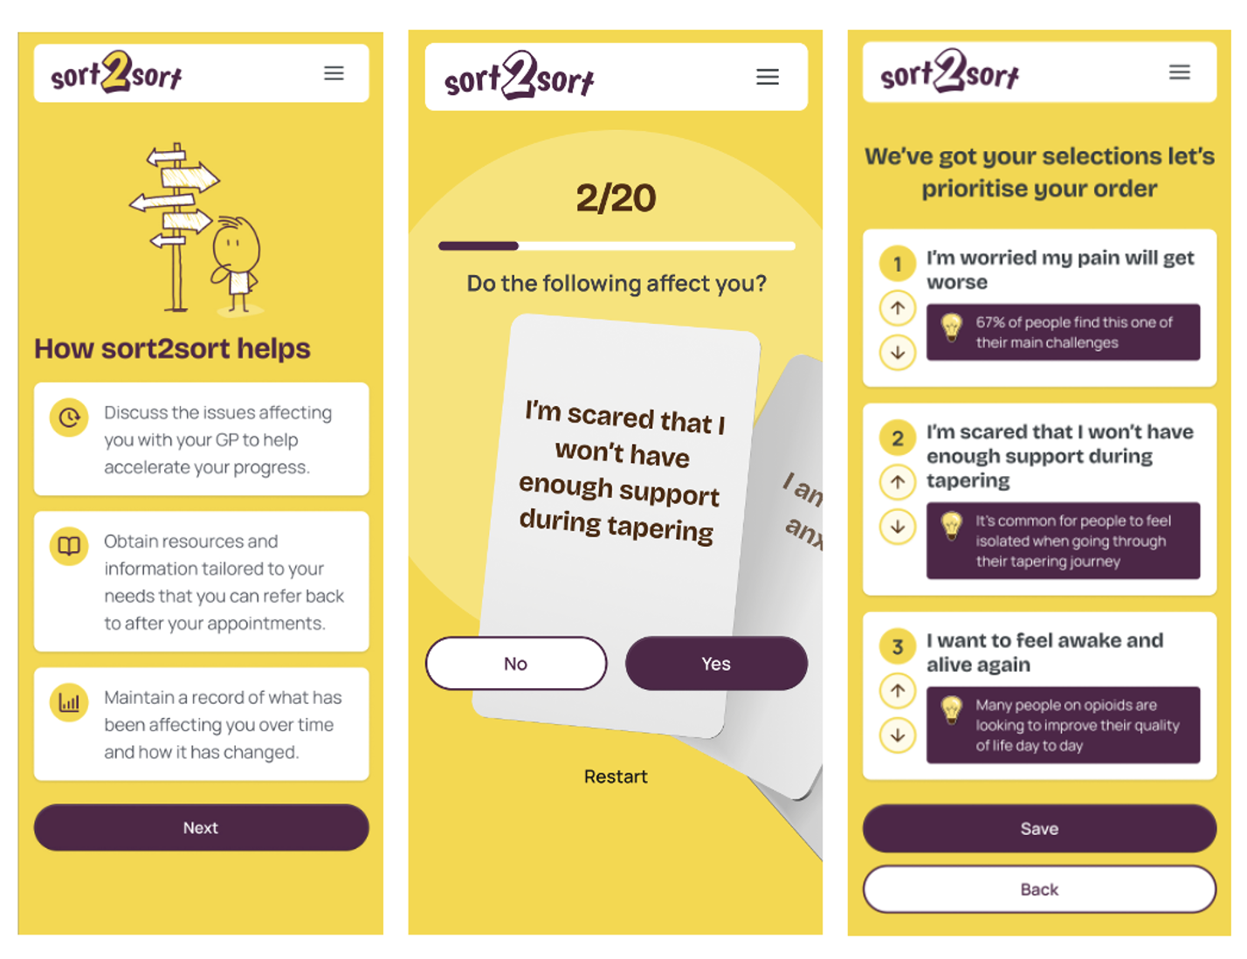
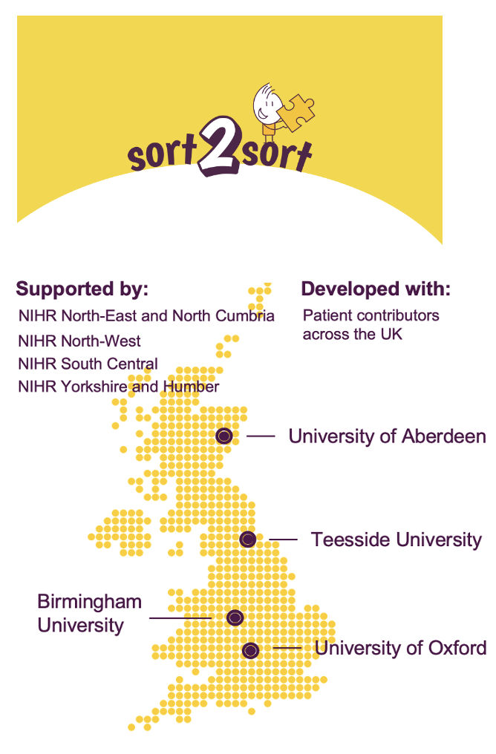
Societal Adaptation Interventions
Reduce AI agency: Compare chatbot vs. card-sorting UIs
Hypothesis:
Trade-off between richer/nuanced representation of patient concerns and safety of the interface

Slide 7
Societal Adaptation Interventions
Reduce AI agency: Compare chatbot vs. card-sorting UIs
Develop a rubric to evaluate unsafe responses with clinician and patient inputs
Track novel markers:
Reinforcement of drug-seeking behavior
Manipulation of AI-mediated interaction
Emotional dependence (e.g., prolonged chatbot use in a PPI group)

Slide 8
Capability-modifying Interventions
Iterative prompt engineering with clinician feedback
Embed evidence-based health info in chatbot responses (using RAG)
Develop bespoke multi-attribute datasets of clinician feedback
Fine-tune LLMs using clinician-rated alignment datasets
Focus: Therapeutic alignment

Slide 9
Thank you! Looking forward to the discussion :)
Team members:
Pranav Mahajan (PhD candidate)
Dr. Katja Wiech
Dr. Jane Quinlan
Prof. Ben Seymour

