Slide 1

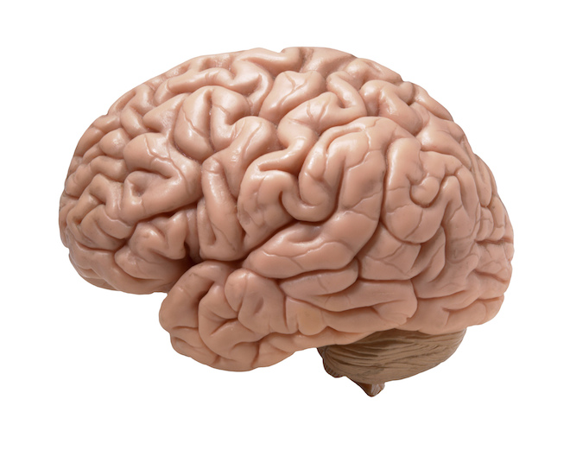

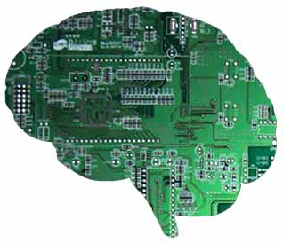
Joint Neurotechnology Network Ethics Event 2025
Ethical Issues in Closed-loop Neural Interface Technologies
Andy Jackson, Professor of Neural Interfaces
Co-Director, Centre for Transformative Neuroscience
Newcastle University

Slide 2
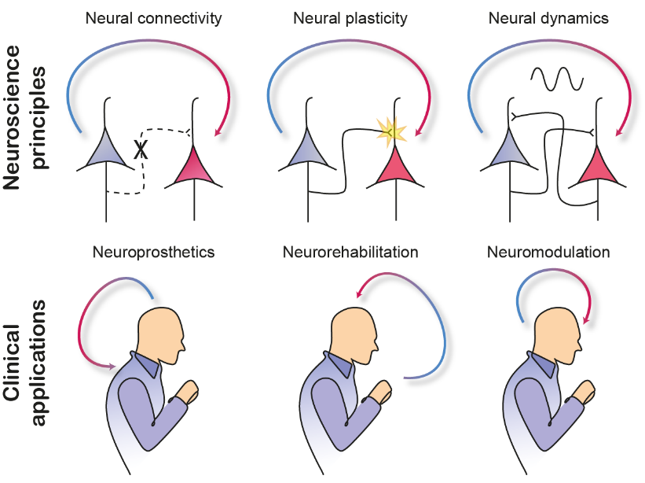
Neuroscientific principles and clinical applications
Many neurological and psychiatric conditions are increasingly seen as disorders of connectivity, plasticity and/or dynamics.
Therefore closed-loop neural interfaces may find multiple applications in neuroprosthetics, neurorehabilitation and neuromodulation.

Slide 3
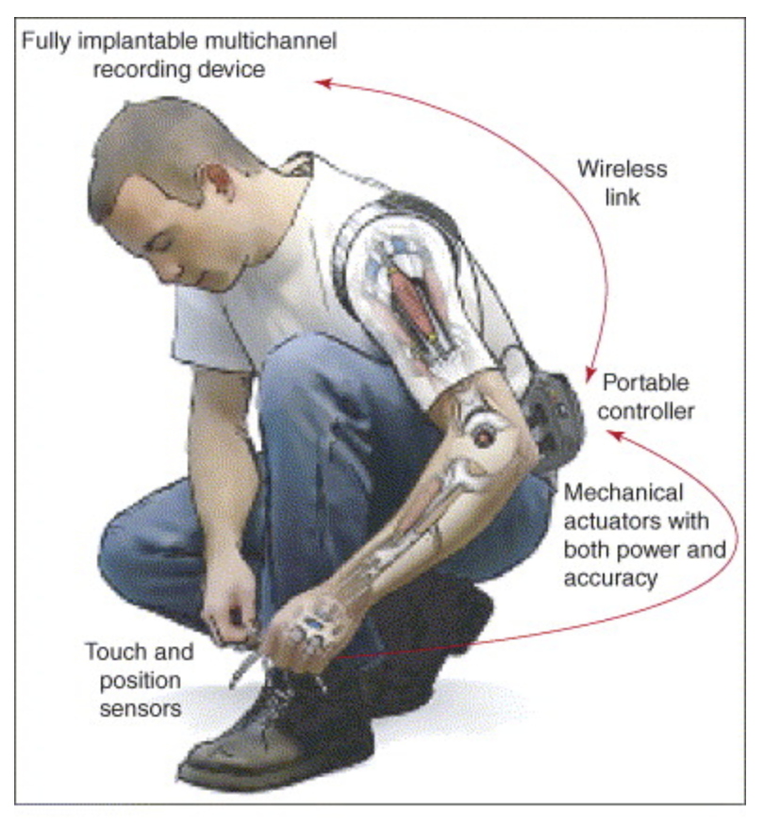
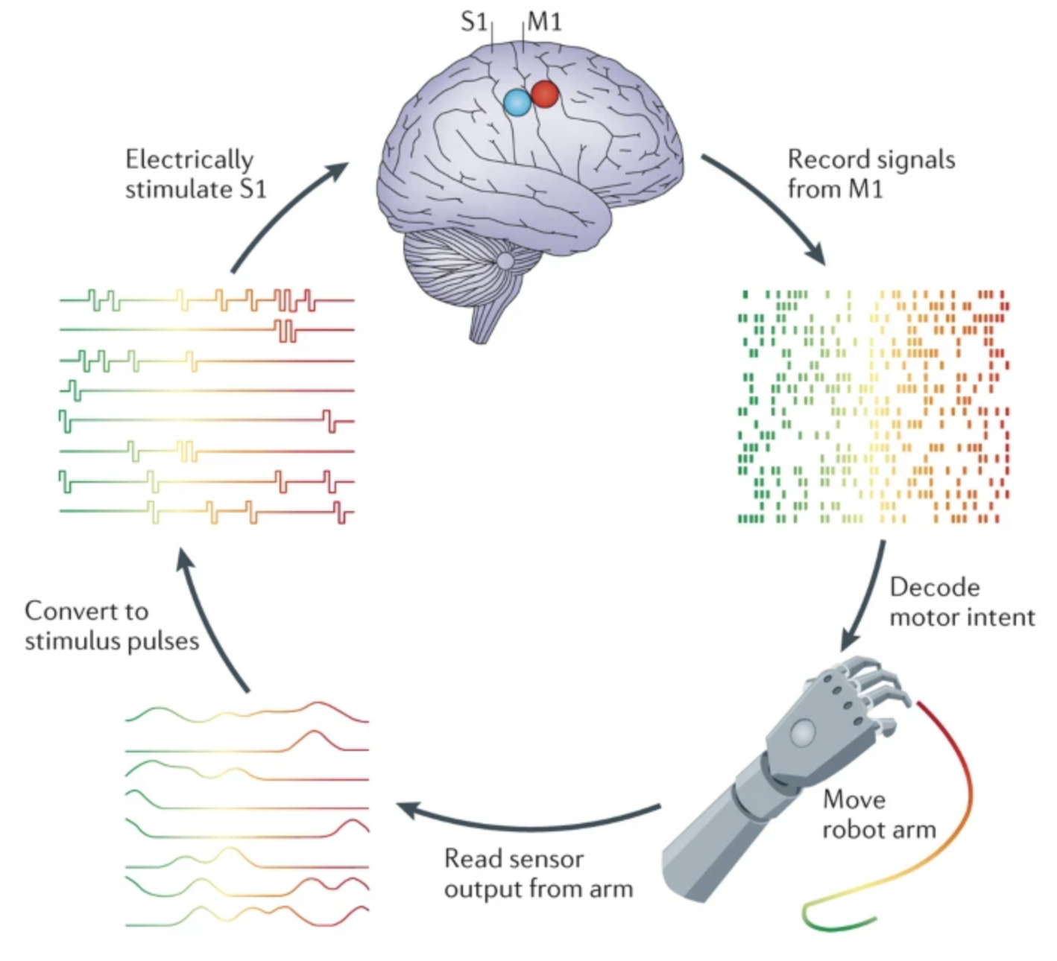
The Brain as the Controller
Sensing
Stimulating
Lebedev, Nicolelis (2006)
Goal state
Command
+
Controller
Plant
-
Feedback
Bensmaia, Miller (2014)

Slide 4
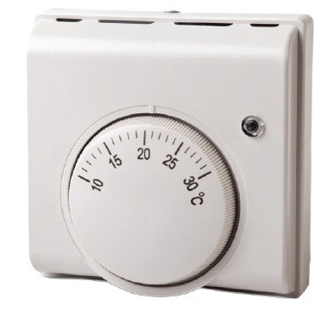
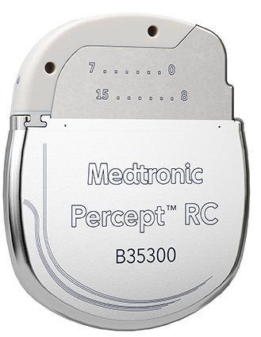
The Technology as the Controller
Sensing
Stimulating
Feedback
Plant
Controller
-
+
Command
Goal state

Slide 5




Coupled dynamical systems
Sensing
Stimulating
$$F(s)$$
$$G(s)$$
-
+
$$H\left(s\right)$$
Taipei 101, Taiwan

Slide 6

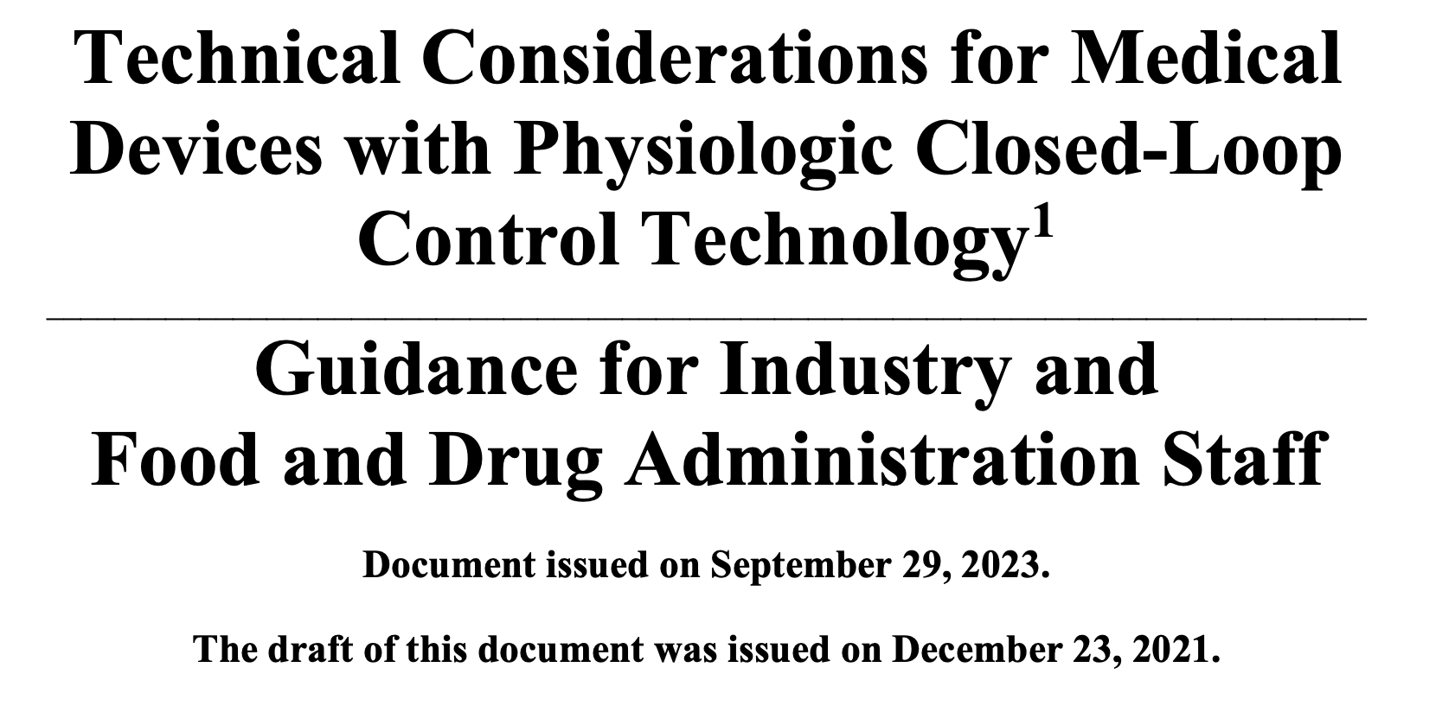
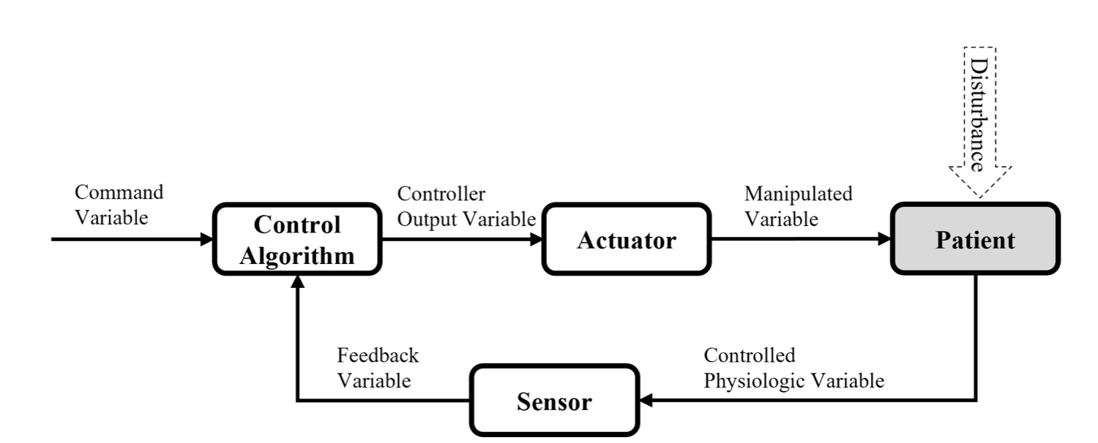
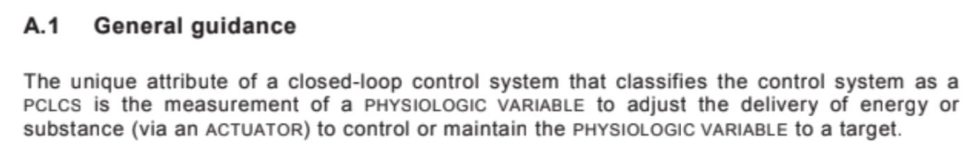
Regulatory standards and guidance: IEC60601

Slide 7
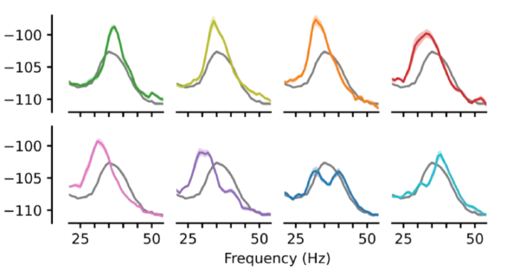
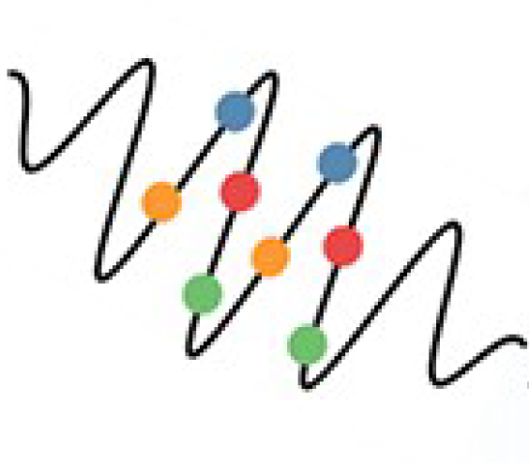
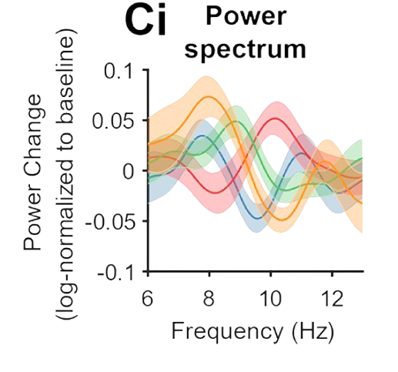
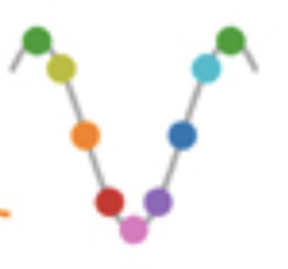
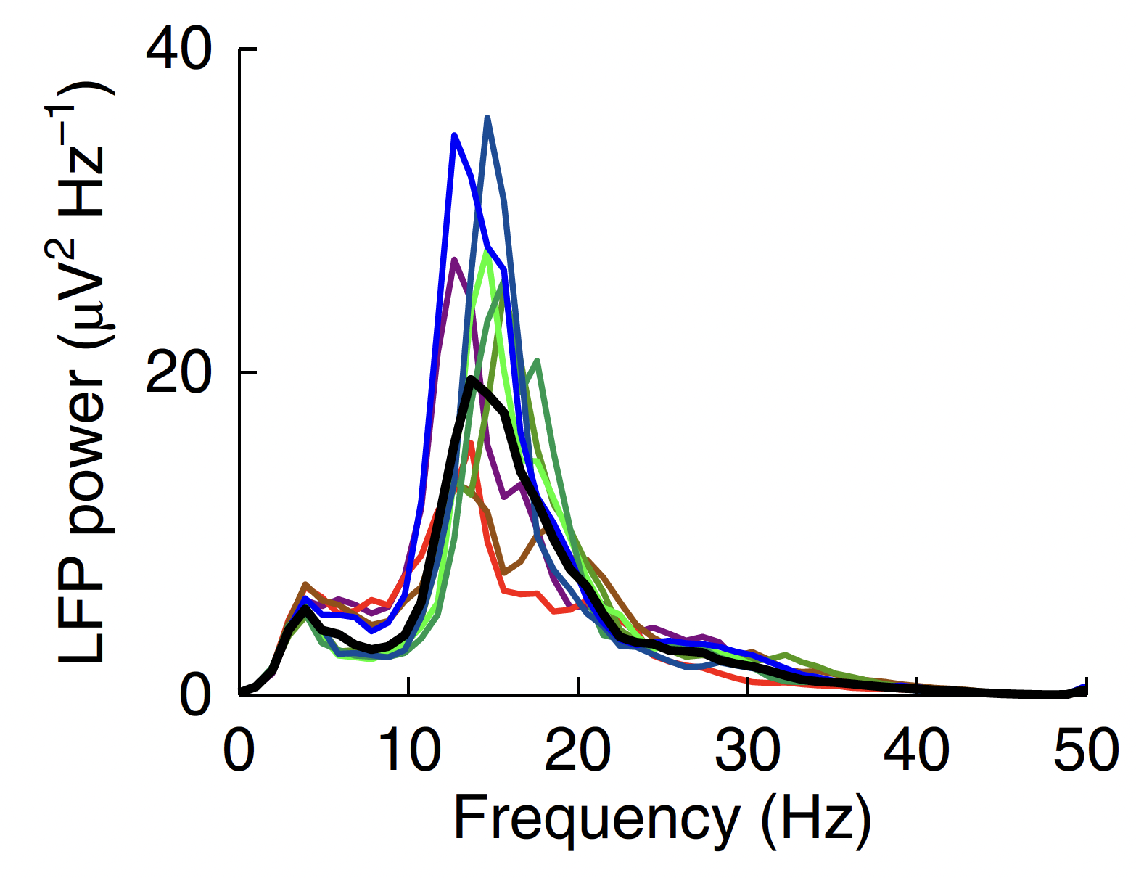
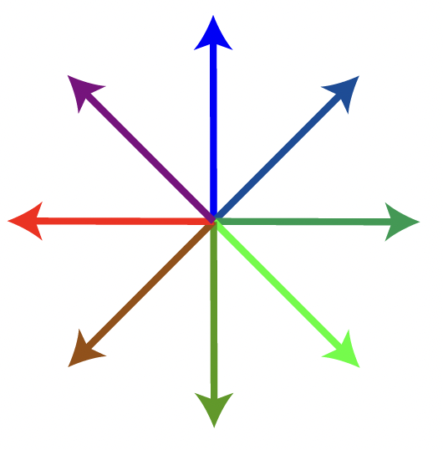
Timing matters
Zaaimi et al. Nat Biomed Eng (2022)
Closed-loop control of seizure oscillations with optogenetic stim
McNamara et al. Cell (2022)
Closed-loop control of parkinsonian beta oscillations with electrical stim
Hebron et al. PLOS Biol (2024)
Closed-loop control of alpha
oscillations with auditory stim
The effects of a stimulus depend on how it is synchronised to brain activity

Slide 8
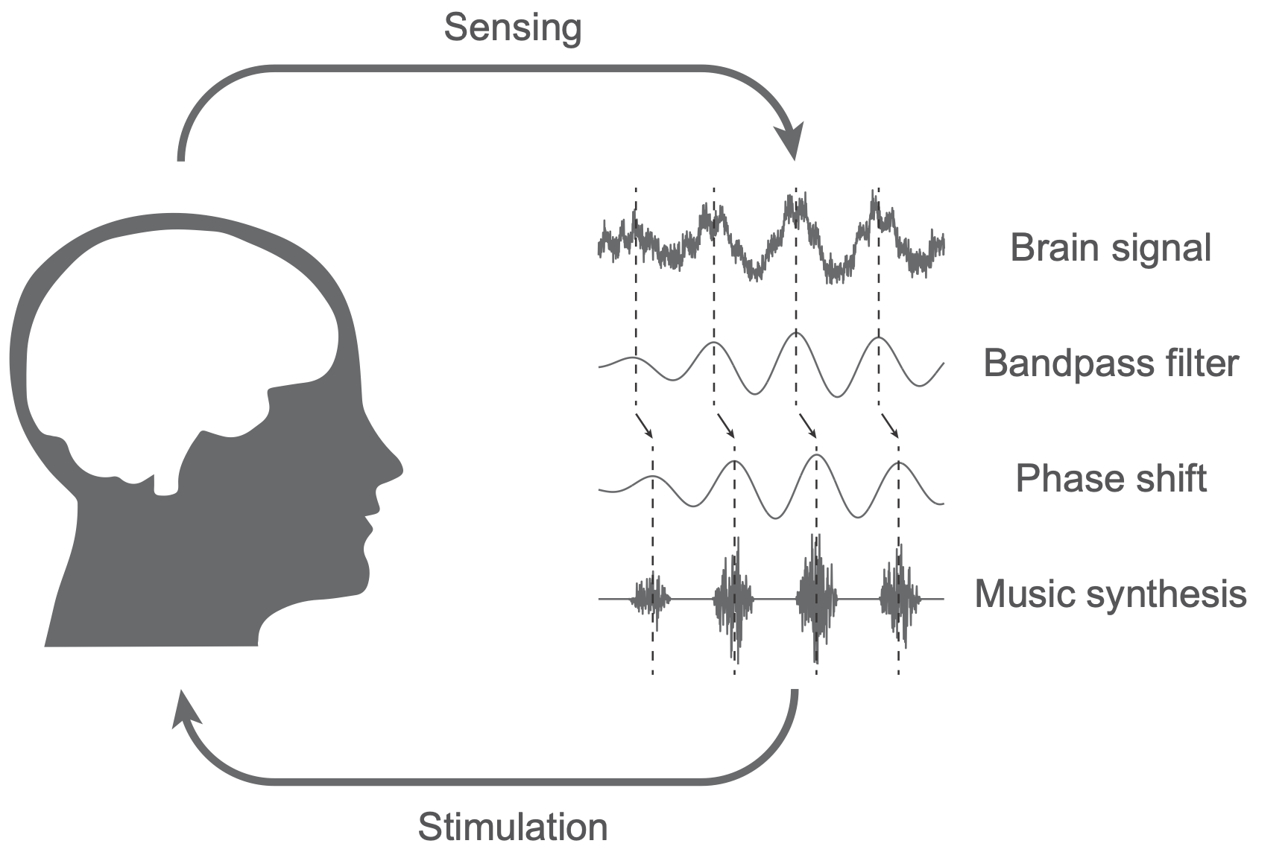
Timing matters
Zaaimi et al. bioarxiv (2024)
Closed-loop control of theta oscillations with musical stimulation
Where a stimulus has effects depend on how it is synchronised to brain activity

Slide 9
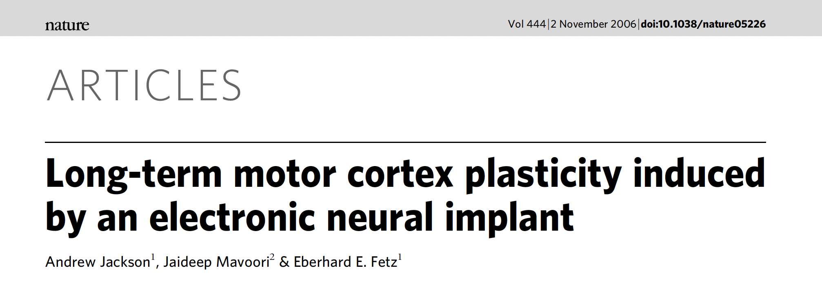
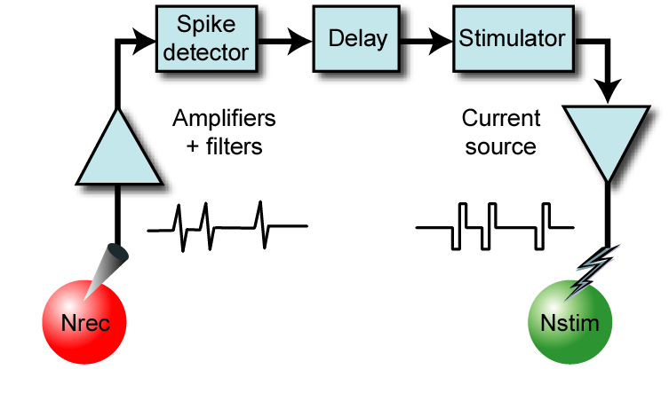
Activity-dependent plasticity
Sensing
Stimulating
Cells that fire together, wire together !
The long-term effects of a stimulus depend on how it is synchronised to brain activity

Slide 10
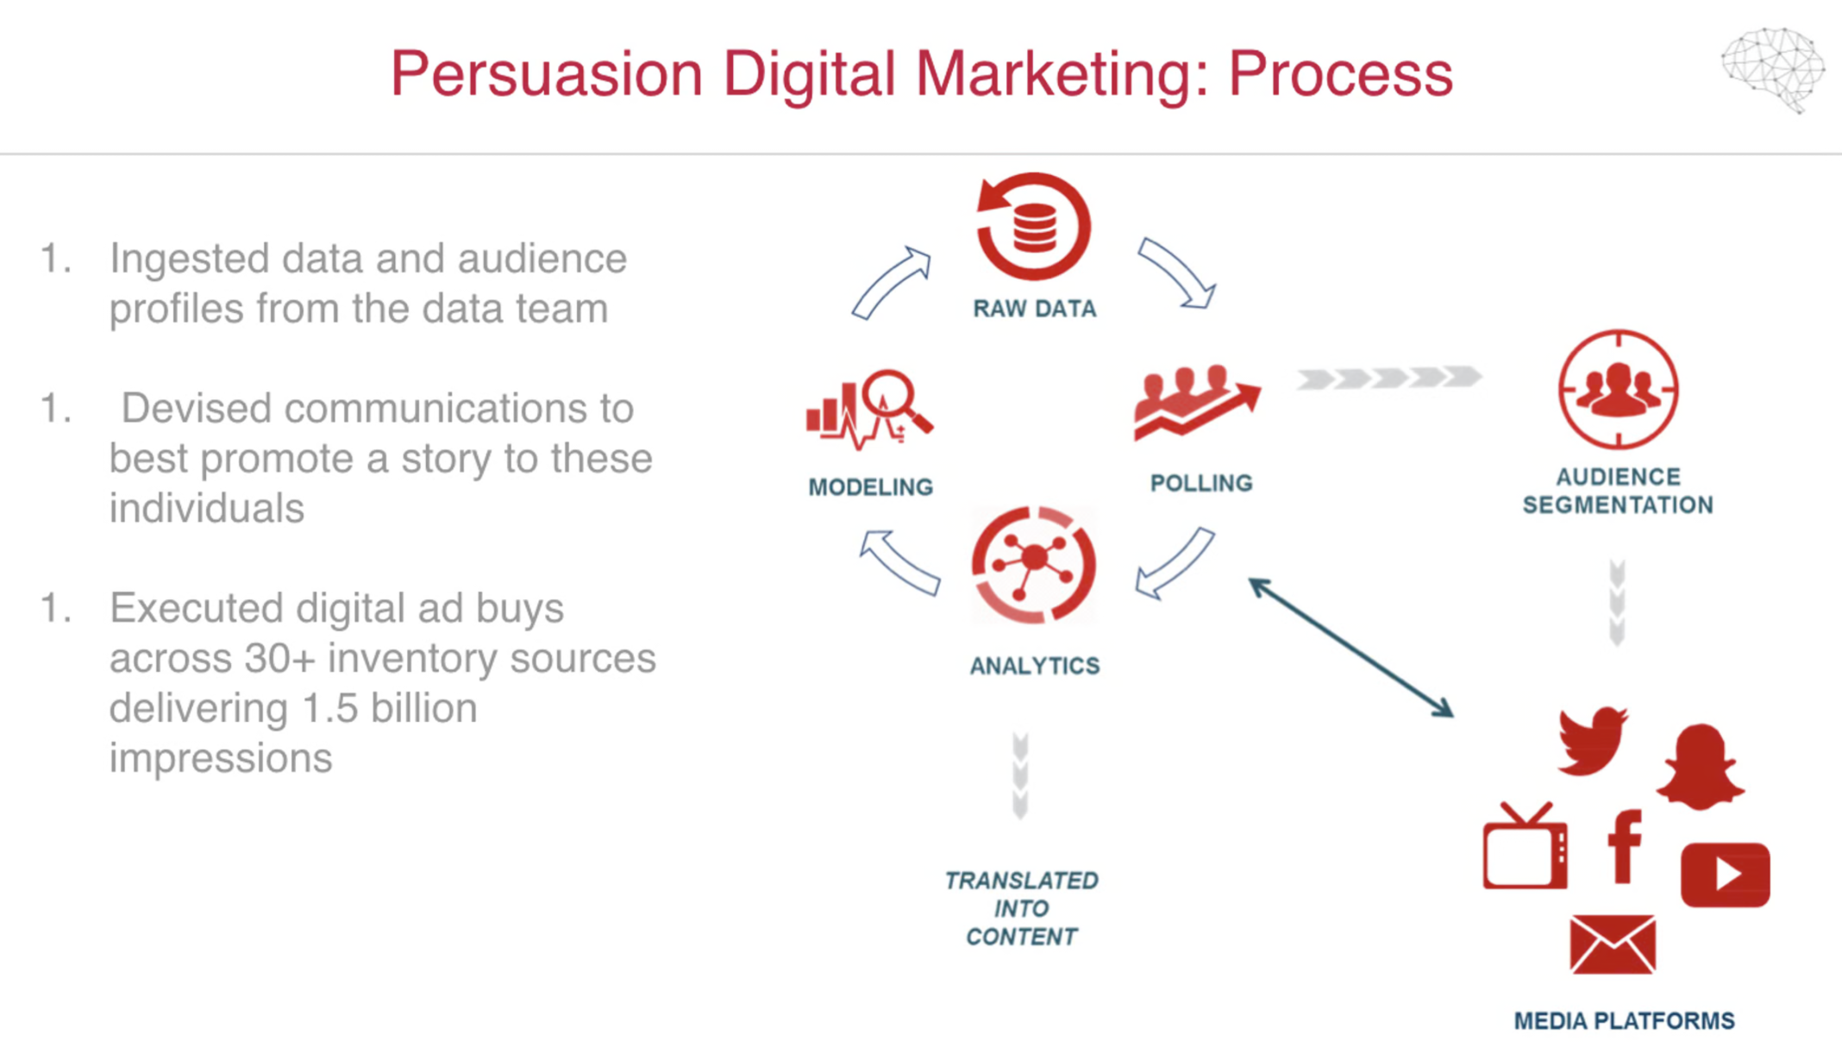
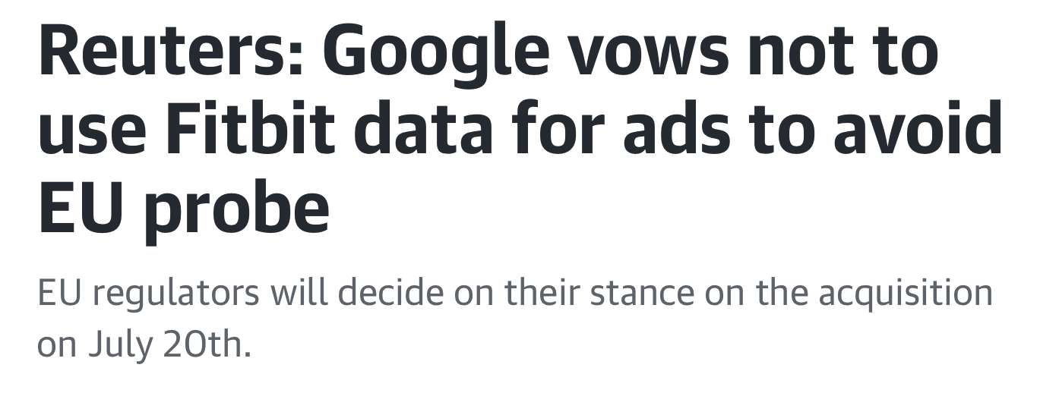
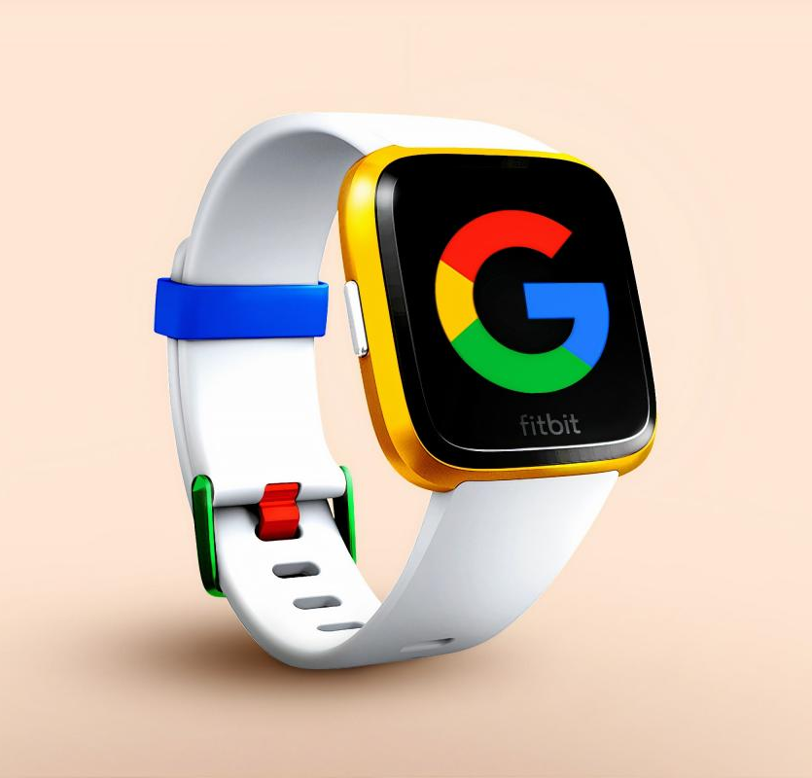
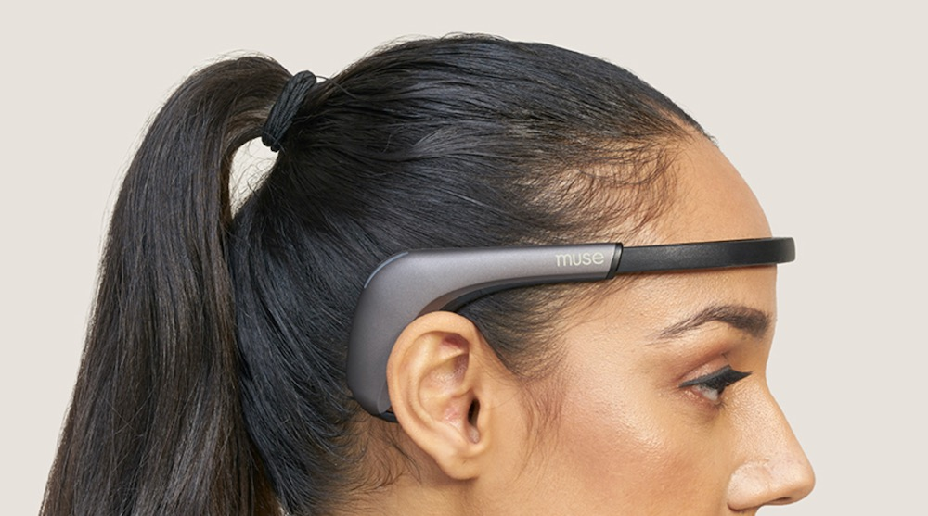



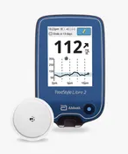
Autonomy
Sensing
Stimulating

Slide 11
Summary
In future, closed-loop neural interfaces may provide a powerful tool to manipulate brain connectivity, plasticity and dynamics for therapeutic purposes
An emerging theme from closeNIT research is that the same stimulus may have opposing effects on brain dynamics depending on when/how it is delivered relative to ongoing brain activity
Establishing the safety and integrity of closed-loop stimulation systems may therefore become challenging. IEC 60601 provides useful guidance but may not cover all scenarios
More generally, brain dynamics operates over multiple time-scales. Closed-loop interfaces may also influence long-term processes such as activity-dependent plasticity
In my view, neural interfaces do not present a new category of risk, but instead bring into sharper focus existing issues around our ever-closer interactions with technology, in particular those relating to privacy and autonomy
Patient and user engagement will be vital for responsible development of these technologies

Slide 12
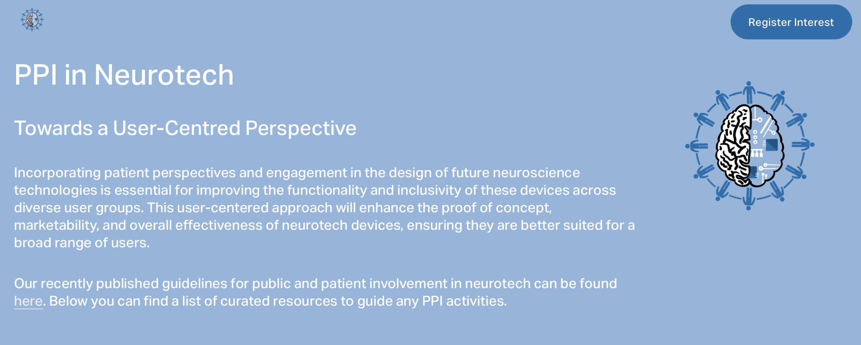
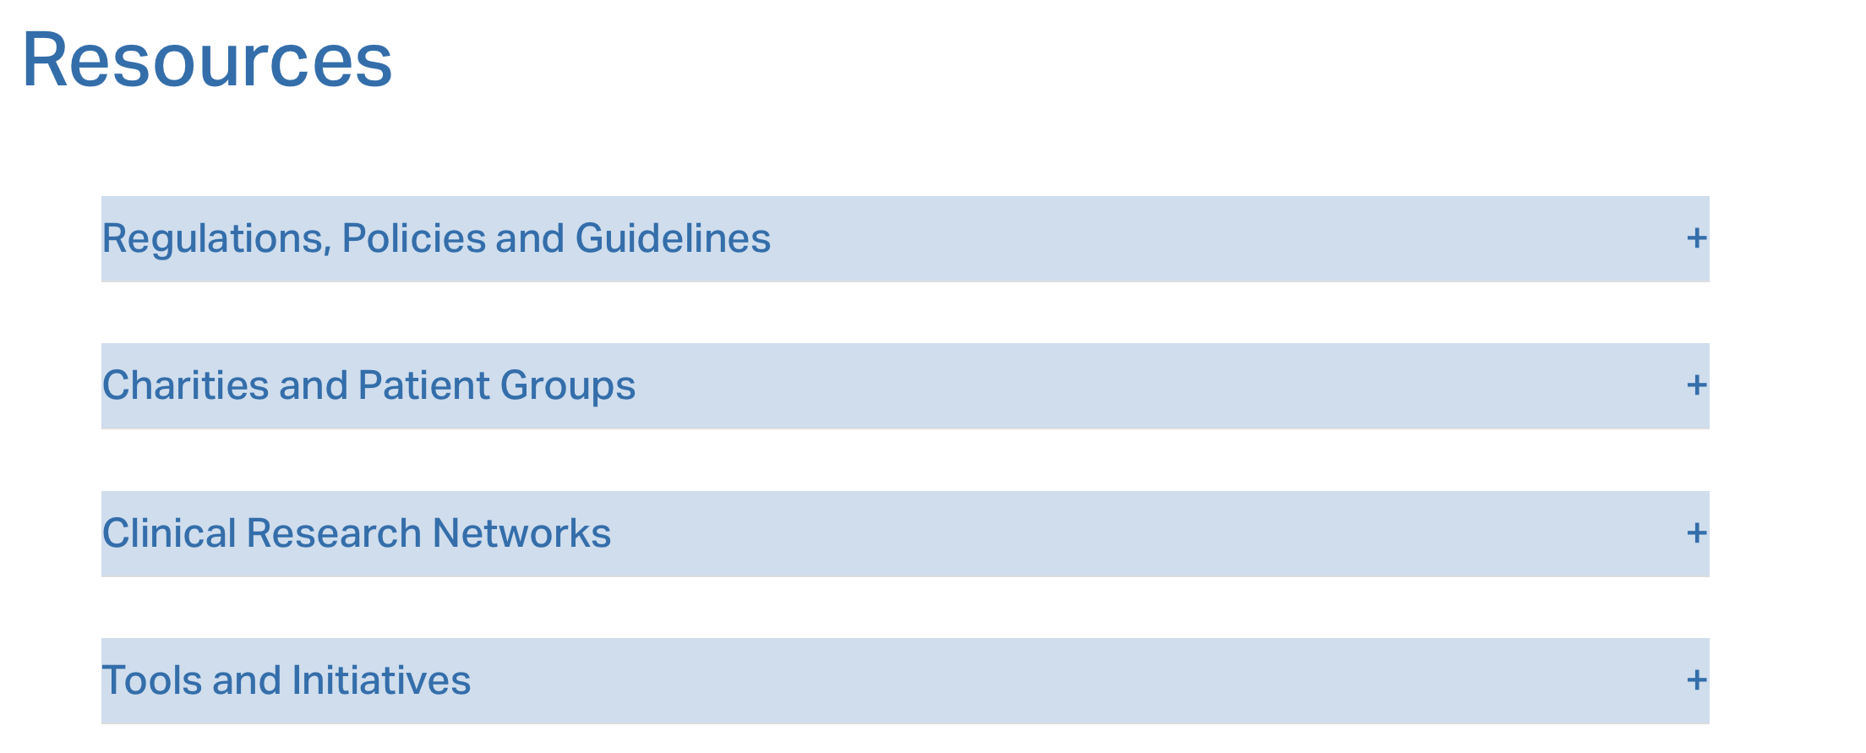
CloseNIT/Neuromod+ Patient Engagement Resource
https://www.inclusive-neurotech.co.uk

